Slide 1

B. Tech Project (8th Semester) PRESENTATION of the project entitled DEVELOPMENT OF INTELLIGENT MODEL USING MACHINE LEARNING NETWORK FOR BRAIN SIGNAL ANALYSIS for the award of the degree of Bachelor of Technology in Electrical Engineering(EE) by ALANKRITA SONOWAL (16-1-3-088) ASHISH RANJAN (16-1-3-091) Under the Supervision of Prof. NIDUL SINHA Department of Electrical Engineering National Institute of Technology, Silchar.

Slide 2
DEVELOPMENT OF INTELLIGENT MODEL USING
MACHINE LEARNING FOR
BRAIN SIGNAL ANALYSIS.

Slide 3
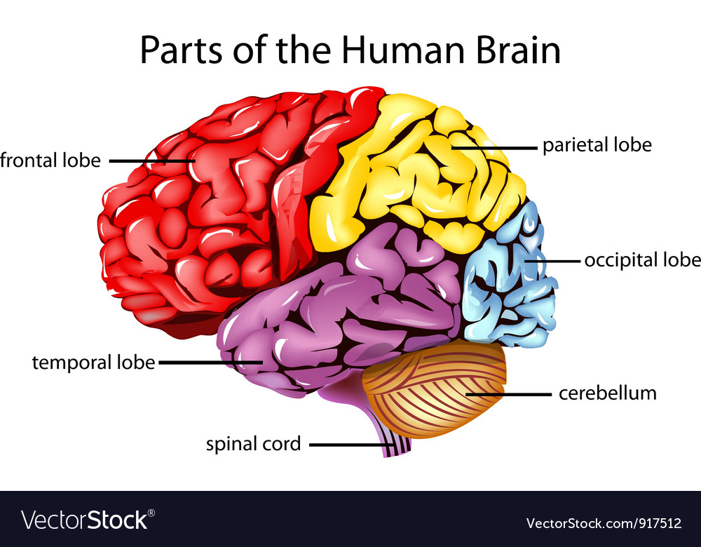
The Human Brain
The brain is the largest and most complex organ of the human body.
It is made up of billions of nerve cells called neurons that communicate by passing electrical or chemical signals through synapses.
A typical neuron consists of soma (cell body),dendrites and axon (extra long, branched cellular filament).

Slide 4
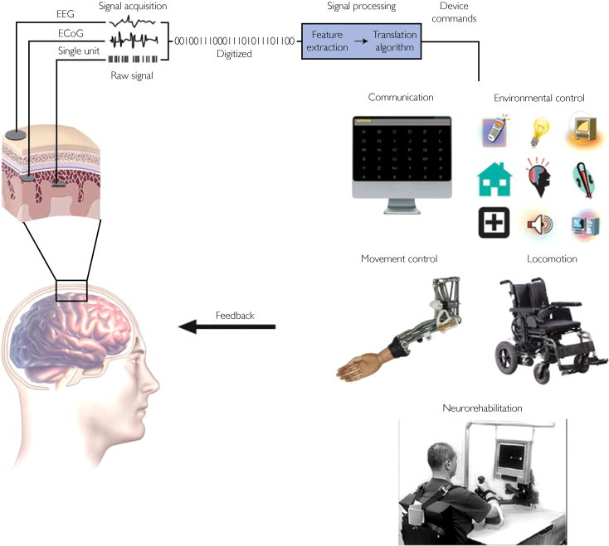
The Brain Waves and BCI
Brain Waves
Brain-Computer Interface(BCI)
Discovered by Hans Berger in 1920s
Synchronized electrical pulses from masses of neurons communicating with each other.
Brain activity is characterized by a combination of brain waves.
Four types of brain waves: Alpha, Beta, Delta, Theta and Gamma grouped on the basis of frequency band in which they lie.
In the Brain Wave signal Analysis we emphasise on Analysis part of BCI system.
A BCI is a computer-based system that acquires brain signals, analyzes them, and translates them into commands that are relayed to an output device to carry out a desired action

Slide 5
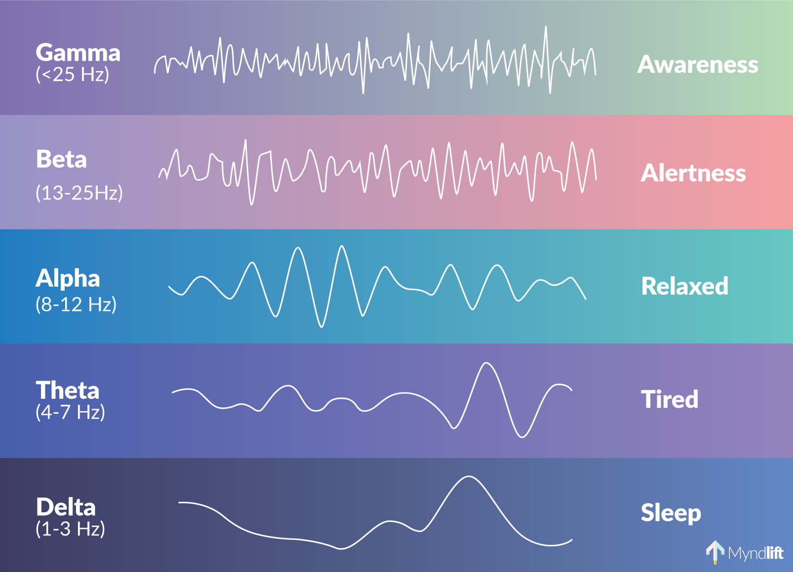
Range of Brain Waves
Courtesy: Myndlift

Slide 6
Methods of Acquiring Brain Signals
A number of options are available based on the type of experiment and availability of recording apparatus such as EEG(Electroencephalogram), NIRS(Near Infrared Spectroscopy), Ecog (Electrocortogram).
Out of the above methods, EEG is preferred for data collection in brain signal analysis because of:
1) High temporal resolution
2) Non-Invasive nature of data acquisition
3) Fast and Dynamic

Slide 7
Data Acquisition Through EEG
The International 10-20 system is an internationally recognized method to describe and apply the location of scalp electrodes.
It is a standard method of obtaining brain signals from four main positions of head:
Nasion
Inion
2 Preauricular Points.
EEG measures the spatial distribution of voltage fields and variation over time which is calculated by taking the sum of excitatory and inhibitory postsynaptic potentials.

Slide 8
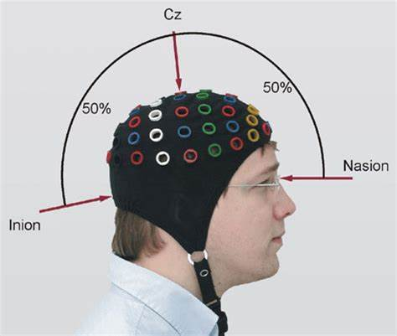
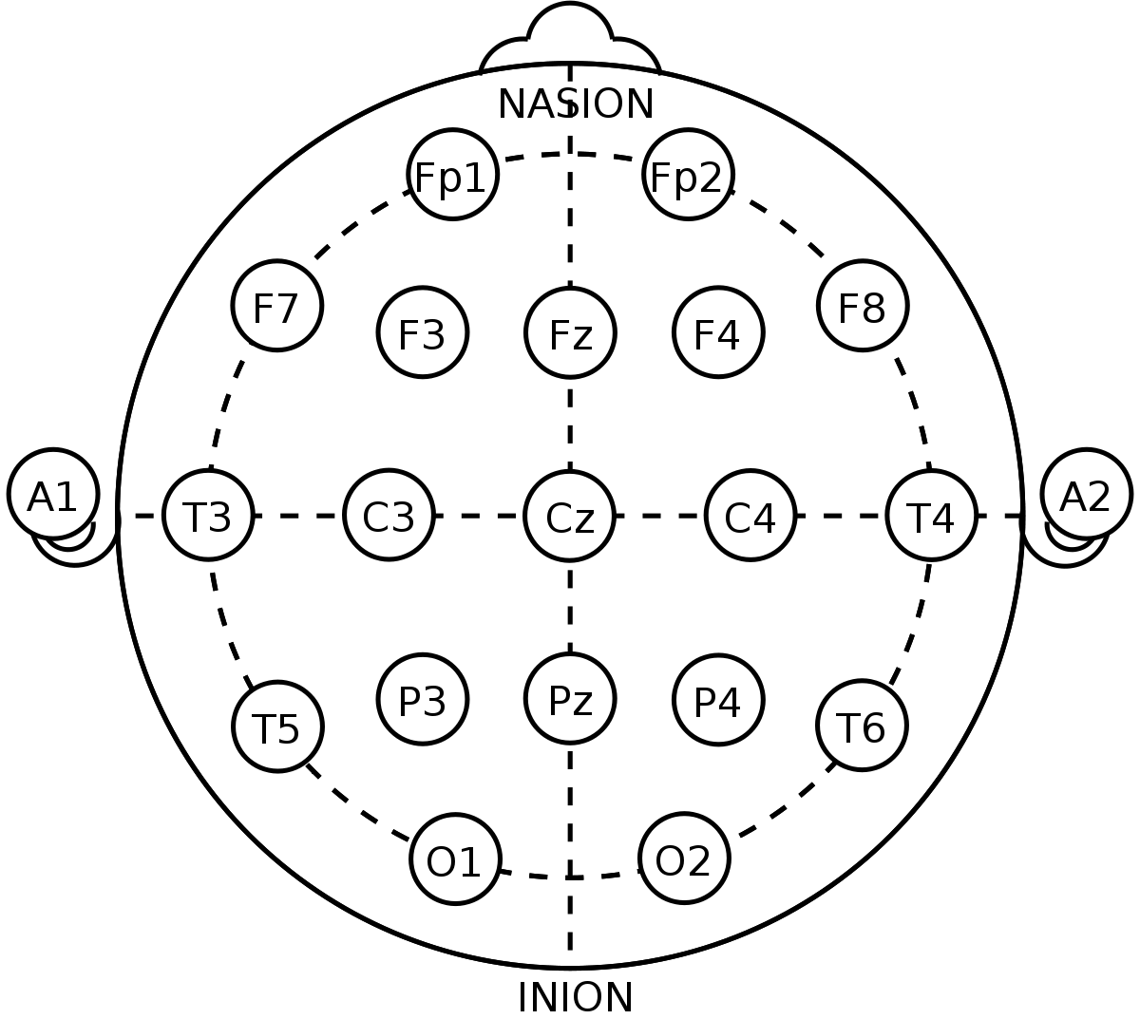
Figures above shows the electrode placement according to 10-20 system

Slide 9
Motivation
Brain Waves Analysis has wide prospects for research as it impacts the:
AI Sector
Medicine Sector
Automation Sector
Psychology Sector
Extensive research is being done and phenomenal results have been derived which points towards the wide scope of the topic.

Slide 10
Objective
Analysis of emotion data obtained through the EEG (Binary Emotion classification)
To extract features for emotion EEG data.
Finally, to develop the intelligent model for emotion detection.

Slide 11
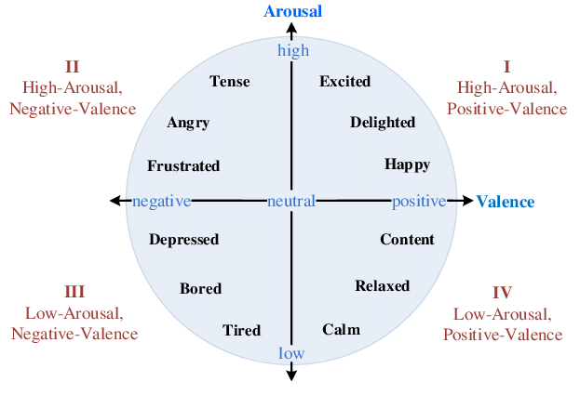
Human Emotions
In general, emotional experiences can be classified into two categories -
Valence
Arousal
Valence is positive or negative
affinity whereas arousal
means how calming or
exciting the information is.
Fig: Valenve-Arousal plane

Slide 12
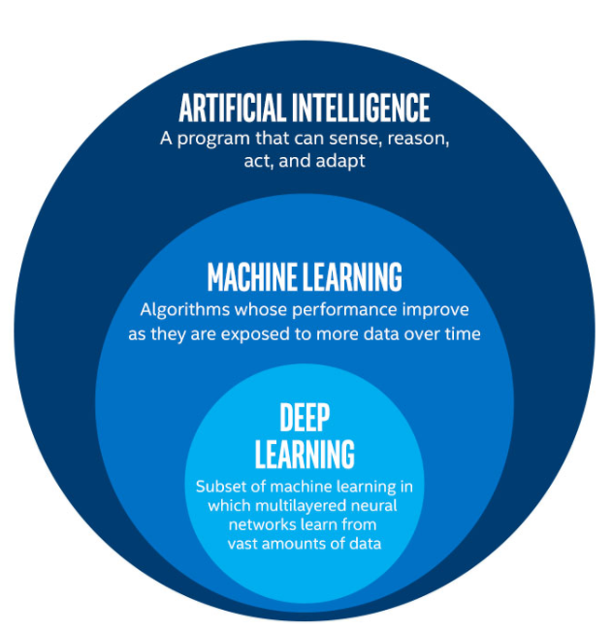
MACHINE LEARNING
Machine learning focuses on the development of computer programs
The primary aim is to allow the computers learn automatically
It is a subset of Artificial Intelligence.

Slide 13
Deap Dataset
Deap Dataset is a database readily availabe for EEG signal analysis
On the basis of online ratings by the users,40 videos were shortlisted for the experiment and emotion data was obtained.
The Dataset is collected from the DEAP dataset total of 8064 samples were collected for each channel for each person in different types of videos for a period of 60 seconds (1 minute). So, for each person, the data is collected in a matrix of 40*40*8064. The further analysis is done based on the data collected.

Slide 14
Data Preparation
The videos rated with High Arousal High Valence and Low Arousal Low Valence for maximum number of times were selected.
The average of the Arousal and Valence ratings of each video was calculated.
The average of Valence and Arousal for each video was further averaged by the formula :
The Net Average gives the 2 videos that are rated High Arousal High Valence(Exp_ID =3) and Low Arousal Low Valence (Exp_ID =23) for maximum number of times.

Slide 15
The Valence and arousal values for videos with Exp_ID s 3 and 23 were averaged for each subject.
Subject 2 and 26 were among the subjects who gave highest ratings for video 3.
Subject 4 and 29 were among the subjects who gave lowest ratings for the video 23.
Hence the most responsive data set was prepared in a form of 128 x 8064 matrix.
With the help of Autoregressive coefficients , 8064 columns was reduced to 63 columns. Thus feature extraction, and dimensionality reduction was done.

Slide 16
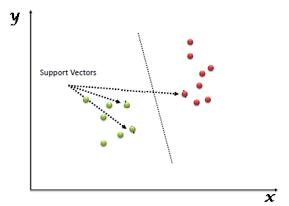
Classification Algorithm
A support Vector Machine (SVM) classifier was used for emotion detection
Here we plot each data item as a point in n-dimensional space.
The extracted features(Autoregressive coefficients) were used as the inputs for the classifier
Graphical Representation of SVM classification: the hyper plane separates the two classes

Slide 17
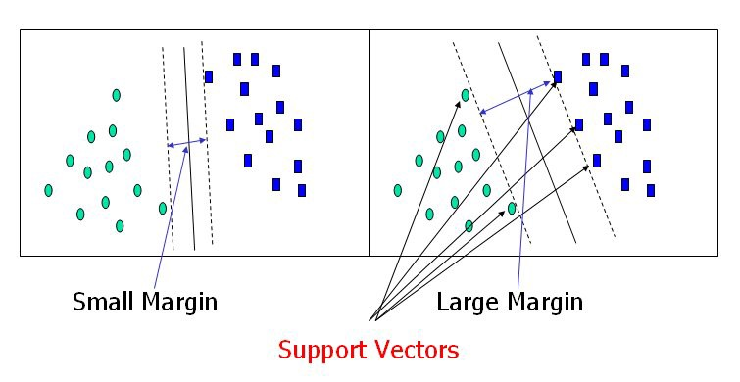
We perform binary classification(LALV and HAHV) by using hyper-plane which are the decision boundaries that help classify the data points.
Fig: SVM and Hyper-planes

Slide 18
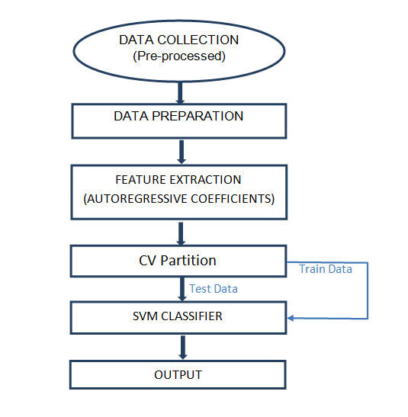
Flowchart on the Working Methodology

Slide 19

Result and Observation
The outputs that the model developed was compared to the DEAP data set.
The results thus found out was 97% accurate.
Accuracy is given by the following formula:

Slide 20
Conclusion
The Brain Wave data quality is best when taken from EEG.
Normal Statistical and Machine Learning models fail as the waves data is very random.
The principle of SVM classifier is proposed and will be applied to study the nature of the data accurately.

Slide 21
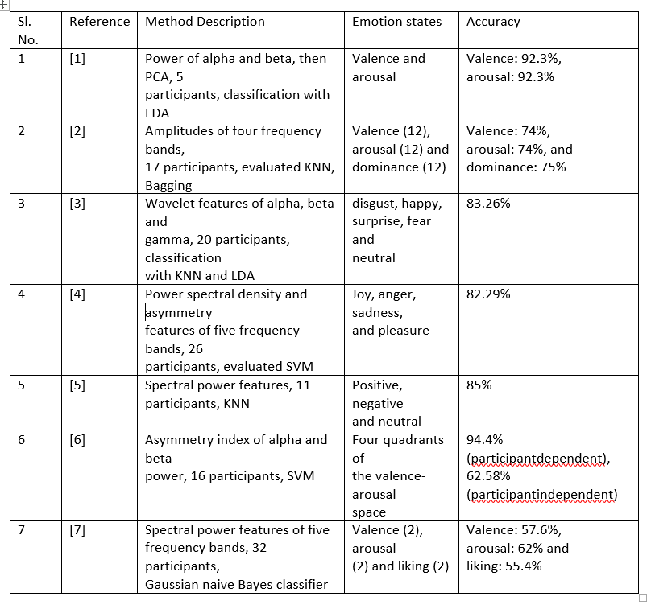
Literature Review

Slide 22
THANK YOU!

